Slide 1

BOOKYOURBOOK
“Trade your books,
change your story”

Slide 2


OUR TEAM
Carmelo Valore
MSc student in Computer science and Engineering
Alessio Russo
MSc student in Computer science and Engineering

Slide 3
TABLE OF CONTENTS
1. INTRODUCTION
2. MOTIVATIONS
4. SWOT ANALYSIS
5. FRAMEWORK
3. APPLICATION FEATURES
6. EXTERNAL LIBRARIES

Slide 4
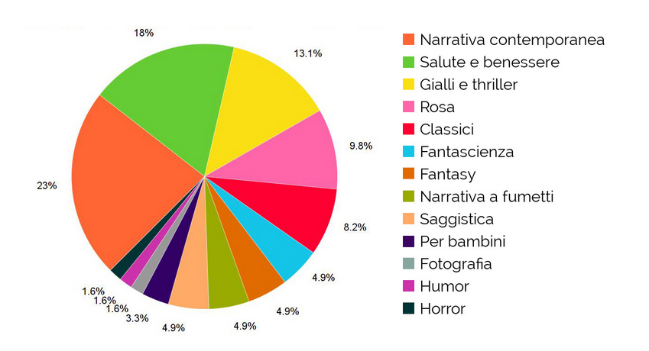
INTRODUCTION
« A reader lives a thousand lives before he dies…
the man who never reads lives only one » – George R.R. Martin
Build a better vocabulary
Improves focus and concentration
Lights up new ideas
Improves memory
Gives new knowledge
Reduces stress

Slide 5

MOTIVATIONS
How many dusty books do you have in your bookshelf?
Covid19-Lockdown caused collapse of reading
Most of books left to dust after reading
Books left in the bookshelf take up space
Desire to read new books
Book exchange is not an opportunity
Sharing of reading preferences
Book readers community
BOOKYOURBOOK

Slide 6
APPLICATION FEATURES
What can the application do?
Sign up / Sign in
Email-Password sign-in, Google sign-in, Continue anonymously
Home page / My books
Book insertion
Insert new books either to sell or to exchange
Search book / Search user
Look for books available, search directly users
Buy book*
Buy / Propose exchanges for one or more books, different payment methods and shipping modes
Profile
General profile info, send/receive reviews, follow/unfollow users, chat with other users, see pending exchanges, see previous orders, favorite books section, etc..
Forum
Start/participate to discussions with other books’ lovers like you!
Notes:
Pagamenti mockati

Slide 7

SWOT ANALYSIS
STRENGHT
User-centric approach
Customizability
WEAKNESSES
Relying on Google Books API
Relying on Firebase API
OPPORTUNITIES
Innovative features
Community based
THREATS
Competitors on book selling

Slide 8


FRAMEWORK
Flutter – Google’s UI toolkit for building natively compiled application
For any device, from a single codebase
Based on Dart
Dart – Client-optimized language for fast apps on any platform
Free & Open source

Slide 9
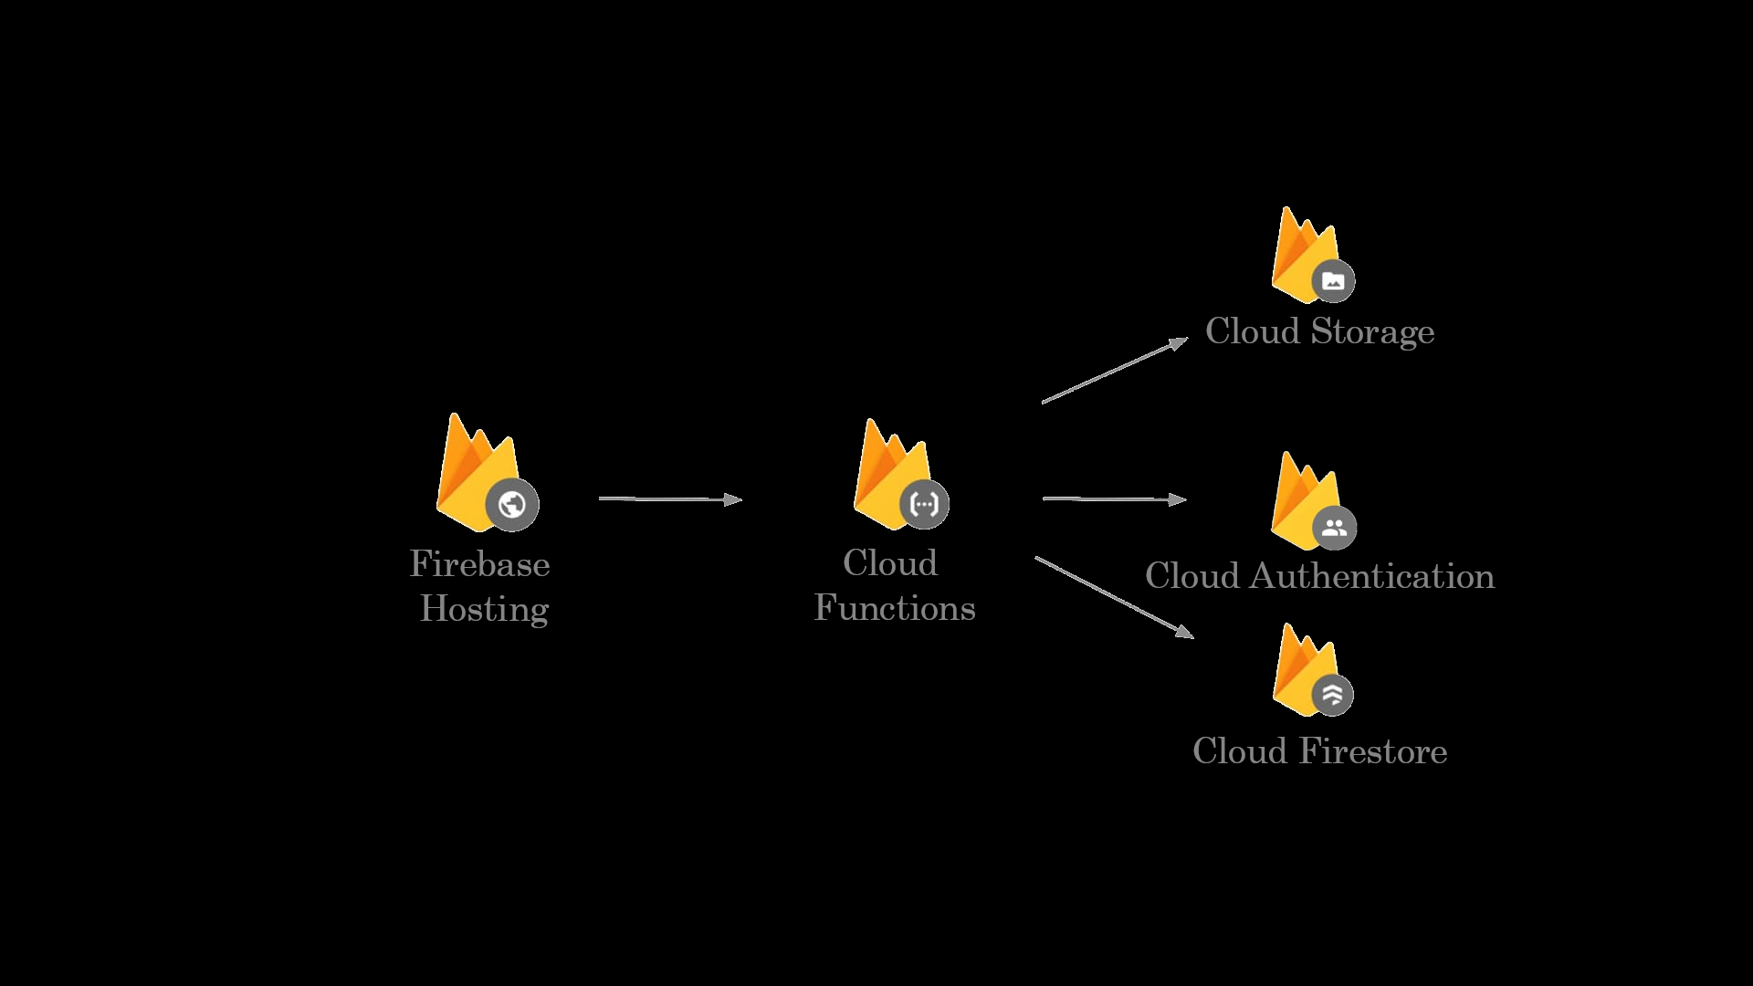
EXTERNAL LIBRARIES
Firebase Cloud Storage
Upload/Download files
Robust operations
Strong security
Scalability
Firebase Cloud Authentication
Email+Password
Google sign-in
Anonymous sign-in
Firebase Cloud Firestore
No-SQL approach
High integration
Scalability

Slide 10

EXTERNAL LIBRARIES
Google Books API – Gives programmatically access to operation available on Google Books website
Search and browse through the list of books that match a given query
View information about a book, including metadata of different type

Slide 11

DEMO
Let’s have a look at the application
Sign up / Sign in
Home page / My books
Book insertion
Search book / Search user
Buy book
Profile
Forum

